Slide 1







Cravify
A Personalized Recipe Recommendation System Using
Multimodal Inputs and Contextual AI.
Isha Kadam
Ankita Darmal
Kasturi Dhopat
Deven deshmukh

Slide 2





"Ever wondered what to cook with the ingredients you have?"

Slide 3
Introduction
Cravify is an AI-powered smart recipe generator and cooking assistant.
It takes user inputs like ingredients, mood, dietary restrictions, and cooking preferences to create personalized recipes.
Uses state-of-the-art NLP and conversational AI to generate structured cooking instructions and engage in natural food-related queries.

Slide 4
Problem Statement
Finding Recipes:
Difficulty in discovering recipes that match limited or specific ingredients.
Information Overload:
Many recipe sources lead to confusion and indecision.
Personalization Gaps:
Lack of tailored recommendations based on individual dietary preferences and available ingredients.

Slide 5
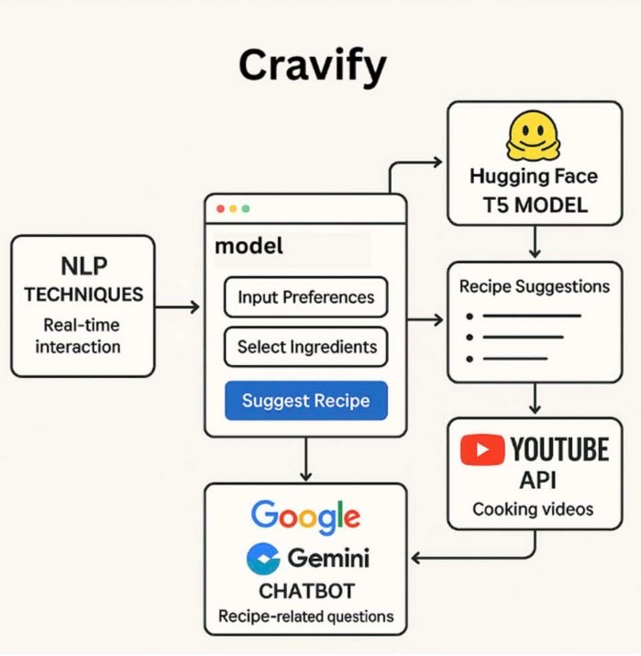
Workflow

Slide 6
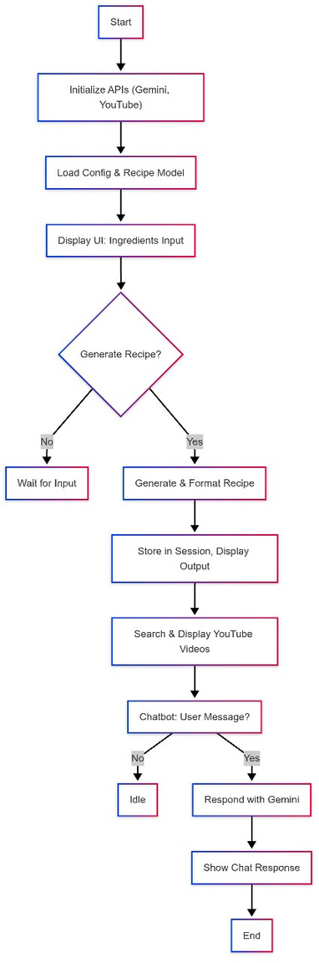
Flowchart

Slide 7



Recipe Ideas
User Inputs:
Mood: Tired
Ingredients: Tomato, Bread, Cheese
Preference: Vegetarian, Quick
Generated Recipe:
Title: Grilled Cheese Tomato Toast
Ingredients: Bread; Tomato slices; Cheese; Butter
Instructions:
Toast bread with butter
Add cheese and tomato slices
Grill for 3–4 mins
Serve hot
 | Breakfast
 | Tomato
 | Bread
 | Cheese

Slide 8
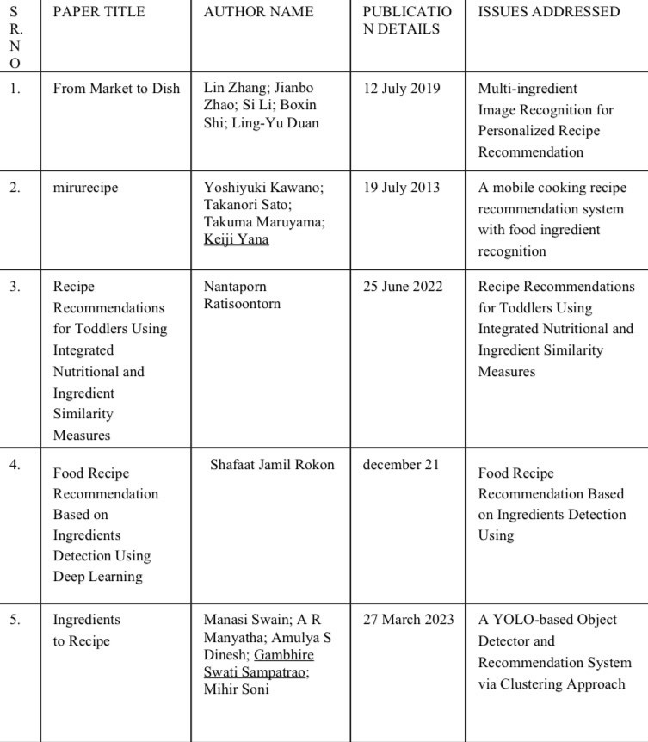
Literature Survey

Slide 9
Future Scope
Integration with Smart Kitchen Devices
Health and Nutrition Personalization
Cross-platform ecosystem
Collaborations with Chefs and Nutritionists.
Integration with E-commerce & Food Delivery Services.

Slide 10
Conclusion
Cravify blends AI, user context, and interactivity into a personalized cooking experience.
It solves real-world problems like decision fatigue and dietary customization.
Combines multiple APIs and ML models to provide a smart, educational, and engaging food assistant.
A promising step towards the future of AI-assisted lifestyle applications.

Slide 11
Refrences
[1] W. Min, S. Jiang, and R. Jain, “Food Recommendation: Framework, Existing Solutions, and Challenges,” IEEE Transactions on Multimedia, vol. 22, no. 10, pp. 2659–2671, Oct. 2020.
[2] M. Gim, S. Park, and C. D. Yoo, “RecipeBowl: A Cooking Recommender for Ingredients and Recipes Using Set Transformer,” IEEE Access, vol. 9, pp. 16084–16097, 2021.
[3]M. Chen, B. Dhingra, and W. Cohen, “Eating Healthier: Exploring Nutrition Information for Healthier Recipe Recommendation,” Information 7 XXX-X-XXXX-XXXX-X/XX/$XX.00 ©20XX IEEE Processing & Management, vol. 57, no. 6, p. 102382, 2020.
[4] J. M. Ordovas, L. R. Ferguson, E. S. Tai, and J. C. Mathers, “Personalised Nutrition and Health,” BMJ, vol. 361, p. k2173, 2018.
[5] R. Mate, M. Kadam, and N. Pawar, “Automated Recipe Chatbot,” International Research Journal
of Modernization in Engineering Technology and Science (IRJMETS), Dec. 2024.

